Slide 1
Data Modeling Using the Entity-Relationship (ER) Model
From Fundamentals of Database Systems by Elmasri/Navathe

Slide 2


Slide 3
Database Design
Requirements collection and analysis
  Document data requirements
  Functional requirements
    User-defined operations (or transactions – including retrievals and updates)
Conceptual Design
  Using a high level conceptual data model
  Concise description of the data requirements
    Entities, relationships and constraints

Slide 4
Database Design (cont’d)
Conceptual Design (cont’d)
  Not concerned with implementation/storage details
  (High-Level) Confirm that conceptual schema meets the identified functional requirements
Logical Design (data model mapping)
  Map conceptual schema to an implementation data model (e.g., relational database model)
Physical Design
  Specify internal storage structures, indices, access paths and file organizations

Slide 5
ER Model
Describes data as
  Entities
  Relationships
  Attributes
    Types of Attributes
      Simple (Atomic) vs Composite Attributes
      Single-Valued vs Multi-Valued Attributes
      Stored vs Derived Attributes
      Complex Attributes (nested composite/multi-valued)
        () composite attribute components
        {} multi-valued

Slide 6
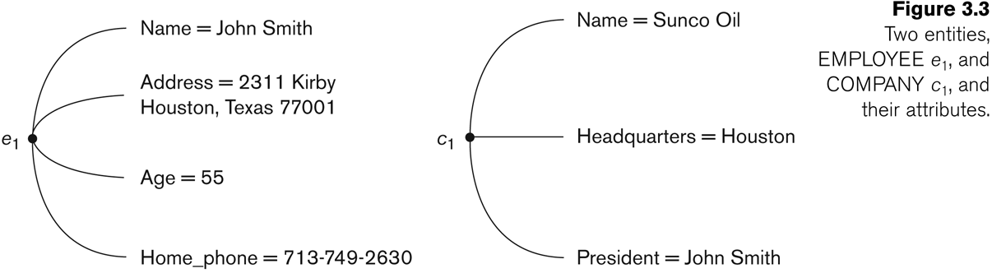

Slide 7


Slide 8
Example: Person can have more than one residence, and each residence can have a single address and multiple phones. Both phone and address are themselves composite attributes.

Slide 9
NULL values
Used when a particular entity may not have an applicable value for an attribute
  e.g., apartment number in address
Or missing/not-known information
  Sales data for a dept that has not been submitted
  Home phone

Slide 10
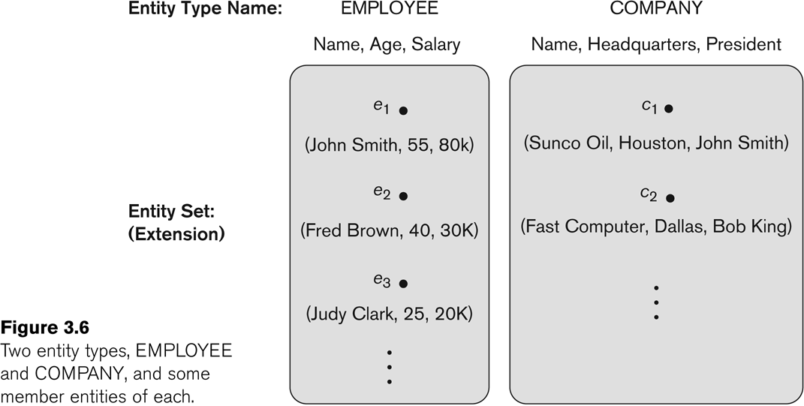
Intension (entity type describes the schema or intension)
Extension of the entity type (collection of entities of a particular entity type grouped into an entity set)

Slide 11
Key Attributes of an Entity Type
Key (uniqueness constraint on attributes)
Key attribute The attribute whose values are distinct for each entity in the entity set
Composite key
  Combination of several attribute values form a key
  Note: such a key must be minimal
May have more than one key
Constraint on all extensions of the entity type

Slide 12


Slide 13
Entity Type
Strong Entity Types
  Entity types that have a key attribute
Weak Entity Type
  Entities that do not have key attributes of their own
  Entities are identified by being related to another entity type (identifying or owner entity type) in combination with one of their attribute values
  Normally has a partial key (set of attributes that can uniquely identify weak entities that are related to some owner entity)
    e.g. if we assume no two dependents have same name, “name” attribute is a partial key
  In order to identify uniquely we need to have the primary key of the owner entity
    (e.g. dependents – name)

Slide 14
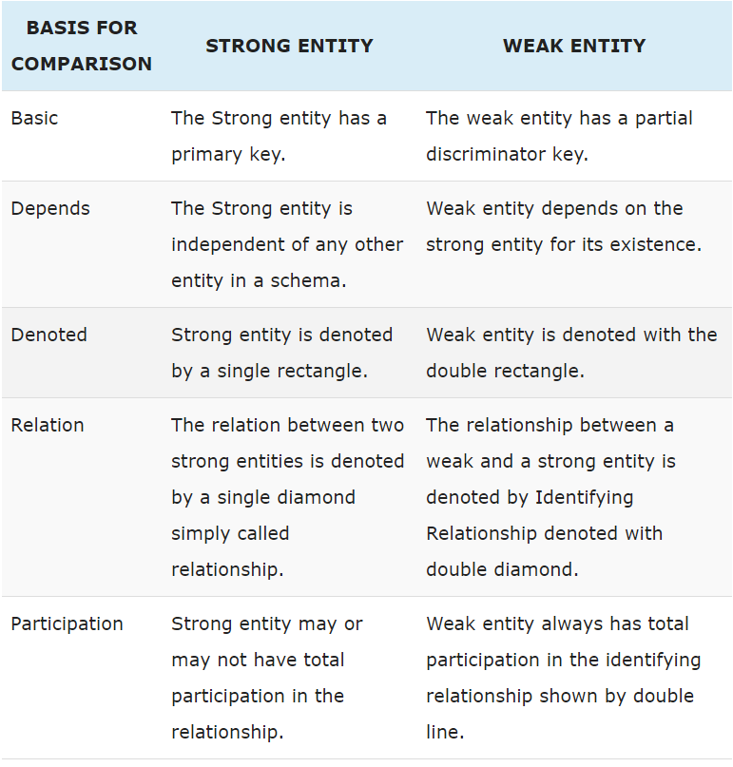

Slide 15


Slide 16
Value Sets (Domains) of Attributes
Each simple attribute is associated with a value set (or domain of values)
Specify the set of values that may be assigned to that attribute
  e.g. value set for name attribute: set of strings of alphabetic characters separated by blank chs.
Not displayed in ER diagrams
  Specified using data types: basic (integer etc.) or additional (date/time etc.)

Slide 17


Slide 18
Relationships
Implicit relationships between entity types are represented as “relationships” in the ER model
A relationship type R among n entity types E1, E2, …, En defines a set of associations – or a relationship set – among entities from these entity types
Each of the individual entities is said to participate in the relationship

Slide 19
Relationships (cont’d)
Degree of a relationship type is the number of participating entity types
  A relationship type of degree of two is called binary
  of three is called ternary
Role Names:
  Each entity type that participates in a relationship plays a particular role in the relationship
Recursive Relationship
  Same entity type participates more than once in a relationship with different roles (e.g., supervision relationship)

Slide 20


Slide 21
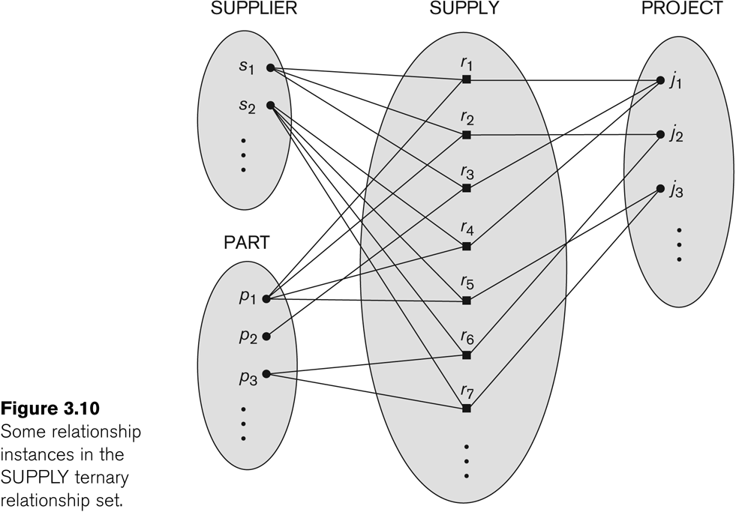

Slide 22


Slide 23
Constraints on Relationship Types
Cardinality Ratios for Binary Relationships
  Specifies the maximum number of relationship instances that an entity can participate in
  e.g., 1:1, 1:N, M:N
Participation Constraints
  Specifies the minimum number of relationship instances that each entity can participate in (minimum cardinality constraint)
  Total Participation (Existence Dependencies)
  Partial Participation
Structural constraints of a relationship type (Cardinality ratio and participation constraints)

Slide 24


Slide 25


Slide 26


Slide 27


Slide 28


Slide 29


Slide 30
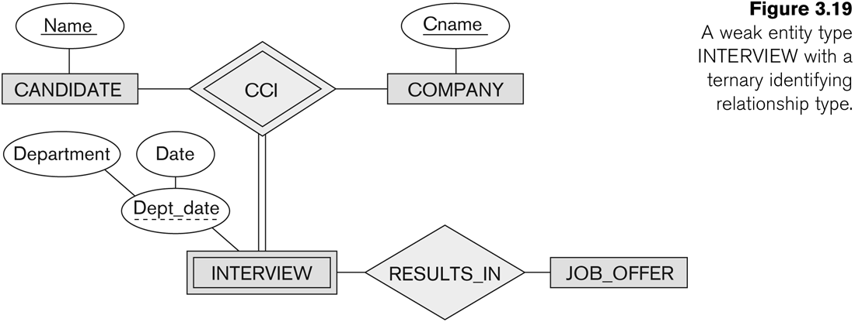

Slide 31
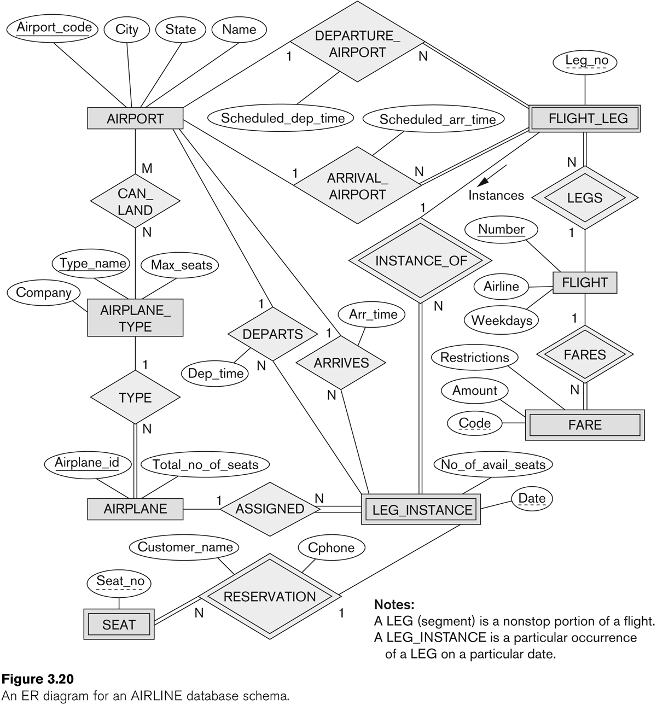

Slide 32
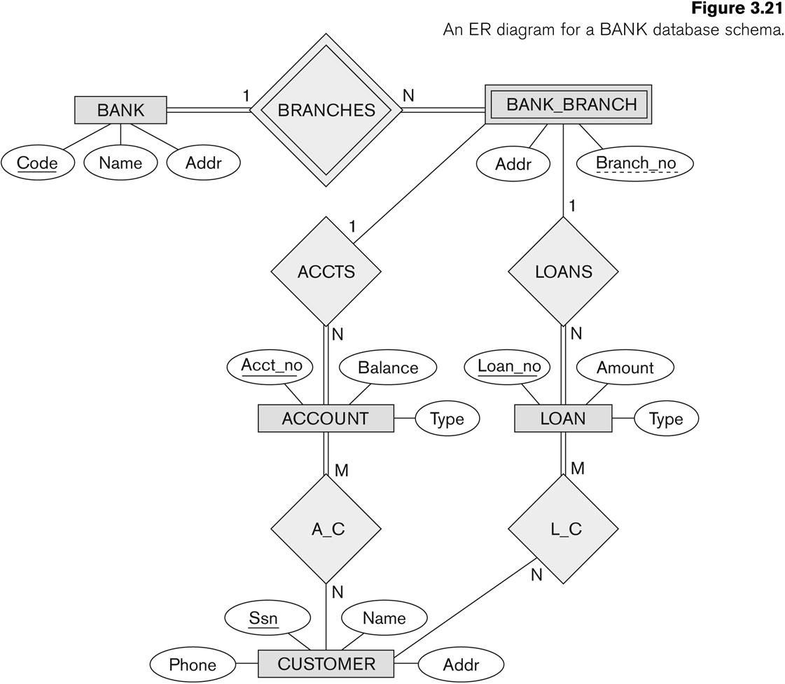

Slide 33
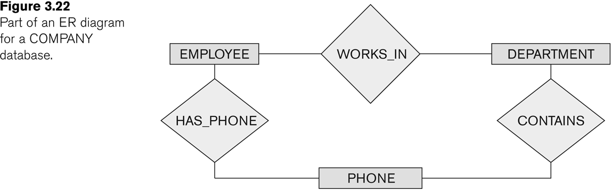

Slide 34
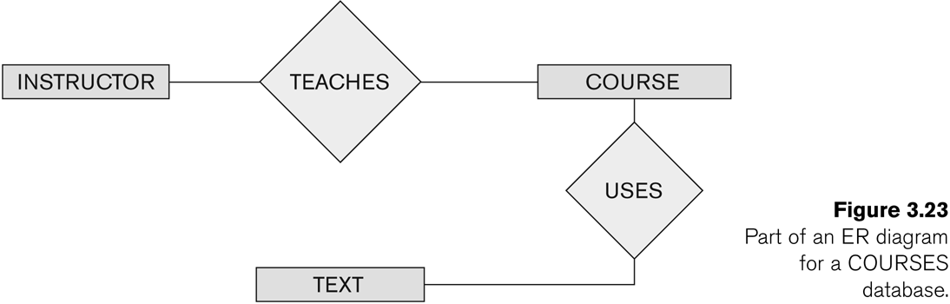

Slide 35
